Slide 1
ENSE 470 - Milestone 7
Timbits
Maksym Zabutnyy, Earl Macalino, Jennifer Herasymuik
April 12th, 2018

Slide 2
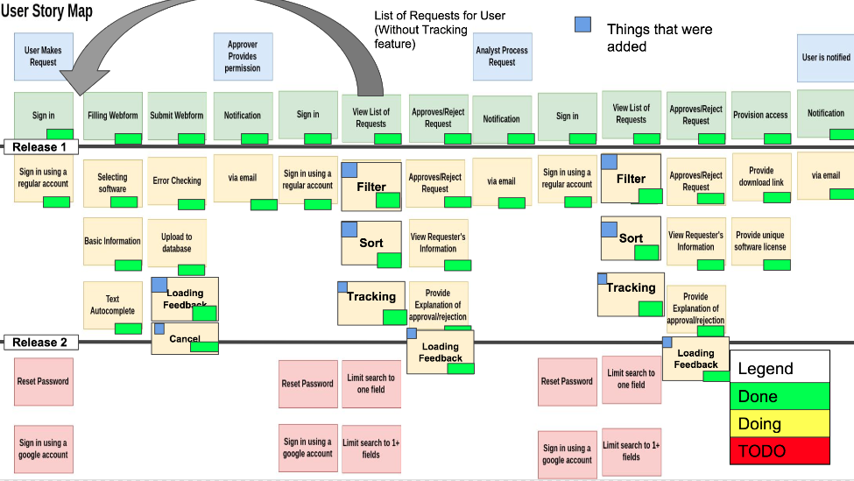
Review of Team GLHF’s MVP
Notes:
Maks

Slide 3
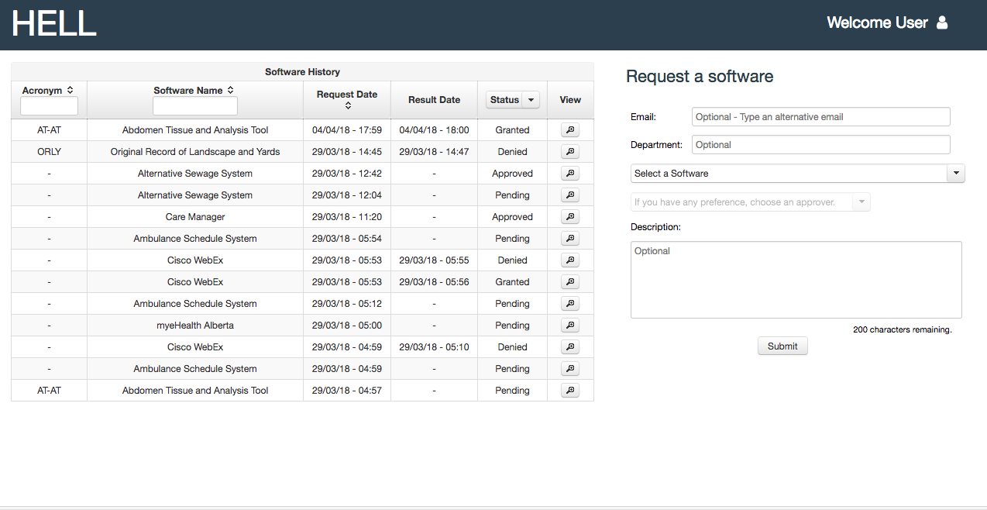
Main Page

Slide 4
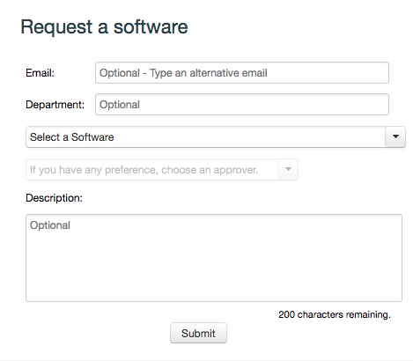
Web Form Component

Slide 5
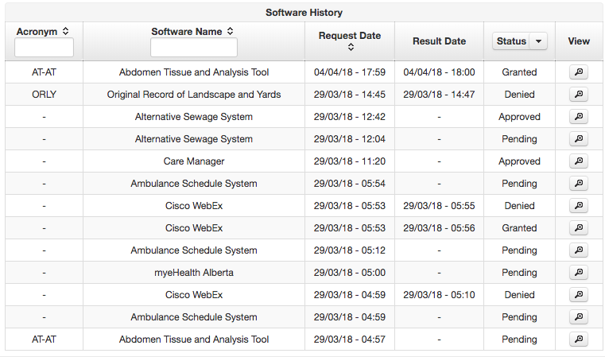
Overview/Status Component

Slide 6
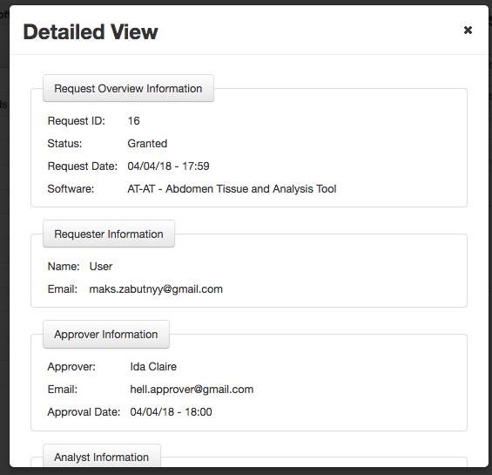
Detailed View Component

Slide 7
Strengths/Areas for Improvement
Strengths:
Simple
Neat
Incredible Functionality
Compact
Areas for Improvement:
The components used on the same page are a little off-balance

Slide 8
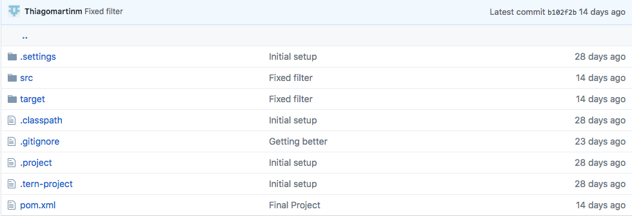
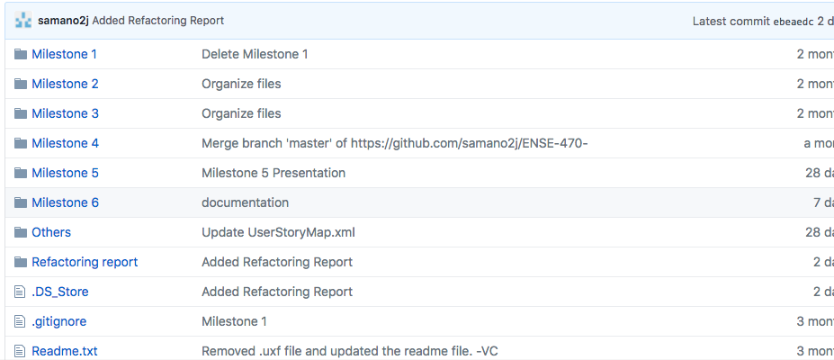
GitHub

Slide 9
Github
There are two GitHubs, potential to merge both
Documentation is present where necessary
Folders are organized and easy to find
Taking over the GitHubs would be simple, good format is followed
Comment on two GitHubs: Separation might lead to reduction of functionality, separating the product from all the specs and documentation might be detrimental. Having a separate GitHub for development keeps it cleaner and organized when using an IDE.
Notes:
Maks

Slide 10
Refactor Review
The code is very easy to understand
Go function and variable names
The files were not to large or overwhelming
Written in Java, which we understand which helps
Uses MVC architecture, files were sorted by type
No code comments in the backend
Wasn’t the end of the world since it was easy to understand anyways
Do all of their test cases pass?
Yes
Notes:
Jenn

Slide 11


Refactoring
Object-Orientation Abuser: Separate Analyst and Approver Bean/Dashboard
Separate Approver and Analyst beans
Separate Approver and Analyst dashboards
A lot of the code was similar or the exact same between the files
Could be combined
Use a super class and have analyst and approver subclass instead?
Then could use one dashboard view instead (or atleast remove all of the duplicated code into a separate file and include it in the approver and dashboard view)
That is the only possible code smell, the web app was very well written

Slide 12
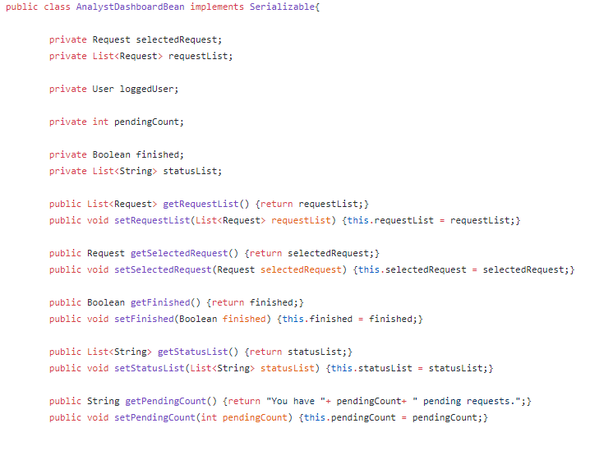
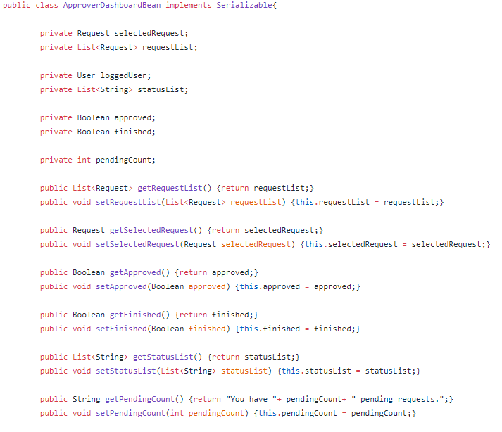
Refactoring - Example

Slide 13
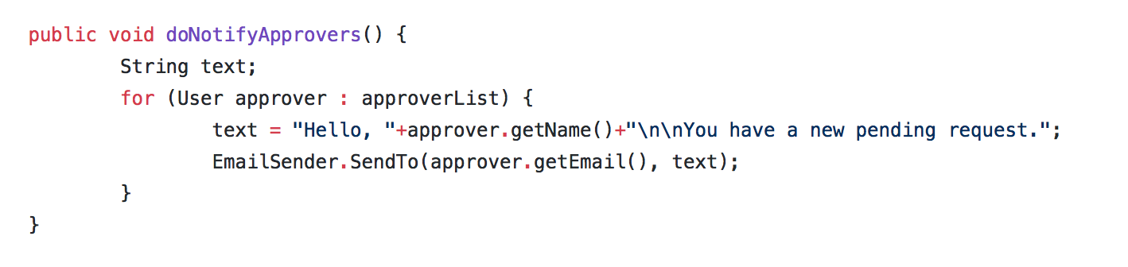
Design Pattern
Observer Pattern
Appropriate because notification for pending requests is needed
Notes:
Earl

Slide 14
Chain of Responsibility
Used for user request
It is well used since the program is a chain made up of links, where each link can either handle a request or pass it up the chain

Slide 15
Team Response

Slide 16
Reflection
How did we feel about this milestone? Likes/dislikes?
Interesting exploring refactoring techniques and learning how to improve code. As well it’s interesting exploring someone else’s solution. Did not like critiquing another group’s work.
What did you learn about yourself as you collaborated and worked through this milestone?
Don’t enjoy having to critique other people’s work in front of a group.
How will you use what you have learned going forward?
Useful for application rewrites.
What “stuff & things” related to this milestone would you want help with?
Nothing really.

